Slide 1



Продажі F
View in Power BI
Last data refresh:
3/4/2019 1:16:28 PM GTB Standard Time
Downloaded at:
3/4/2019 1:56:57 PM GTB Standard Time

Slide 2
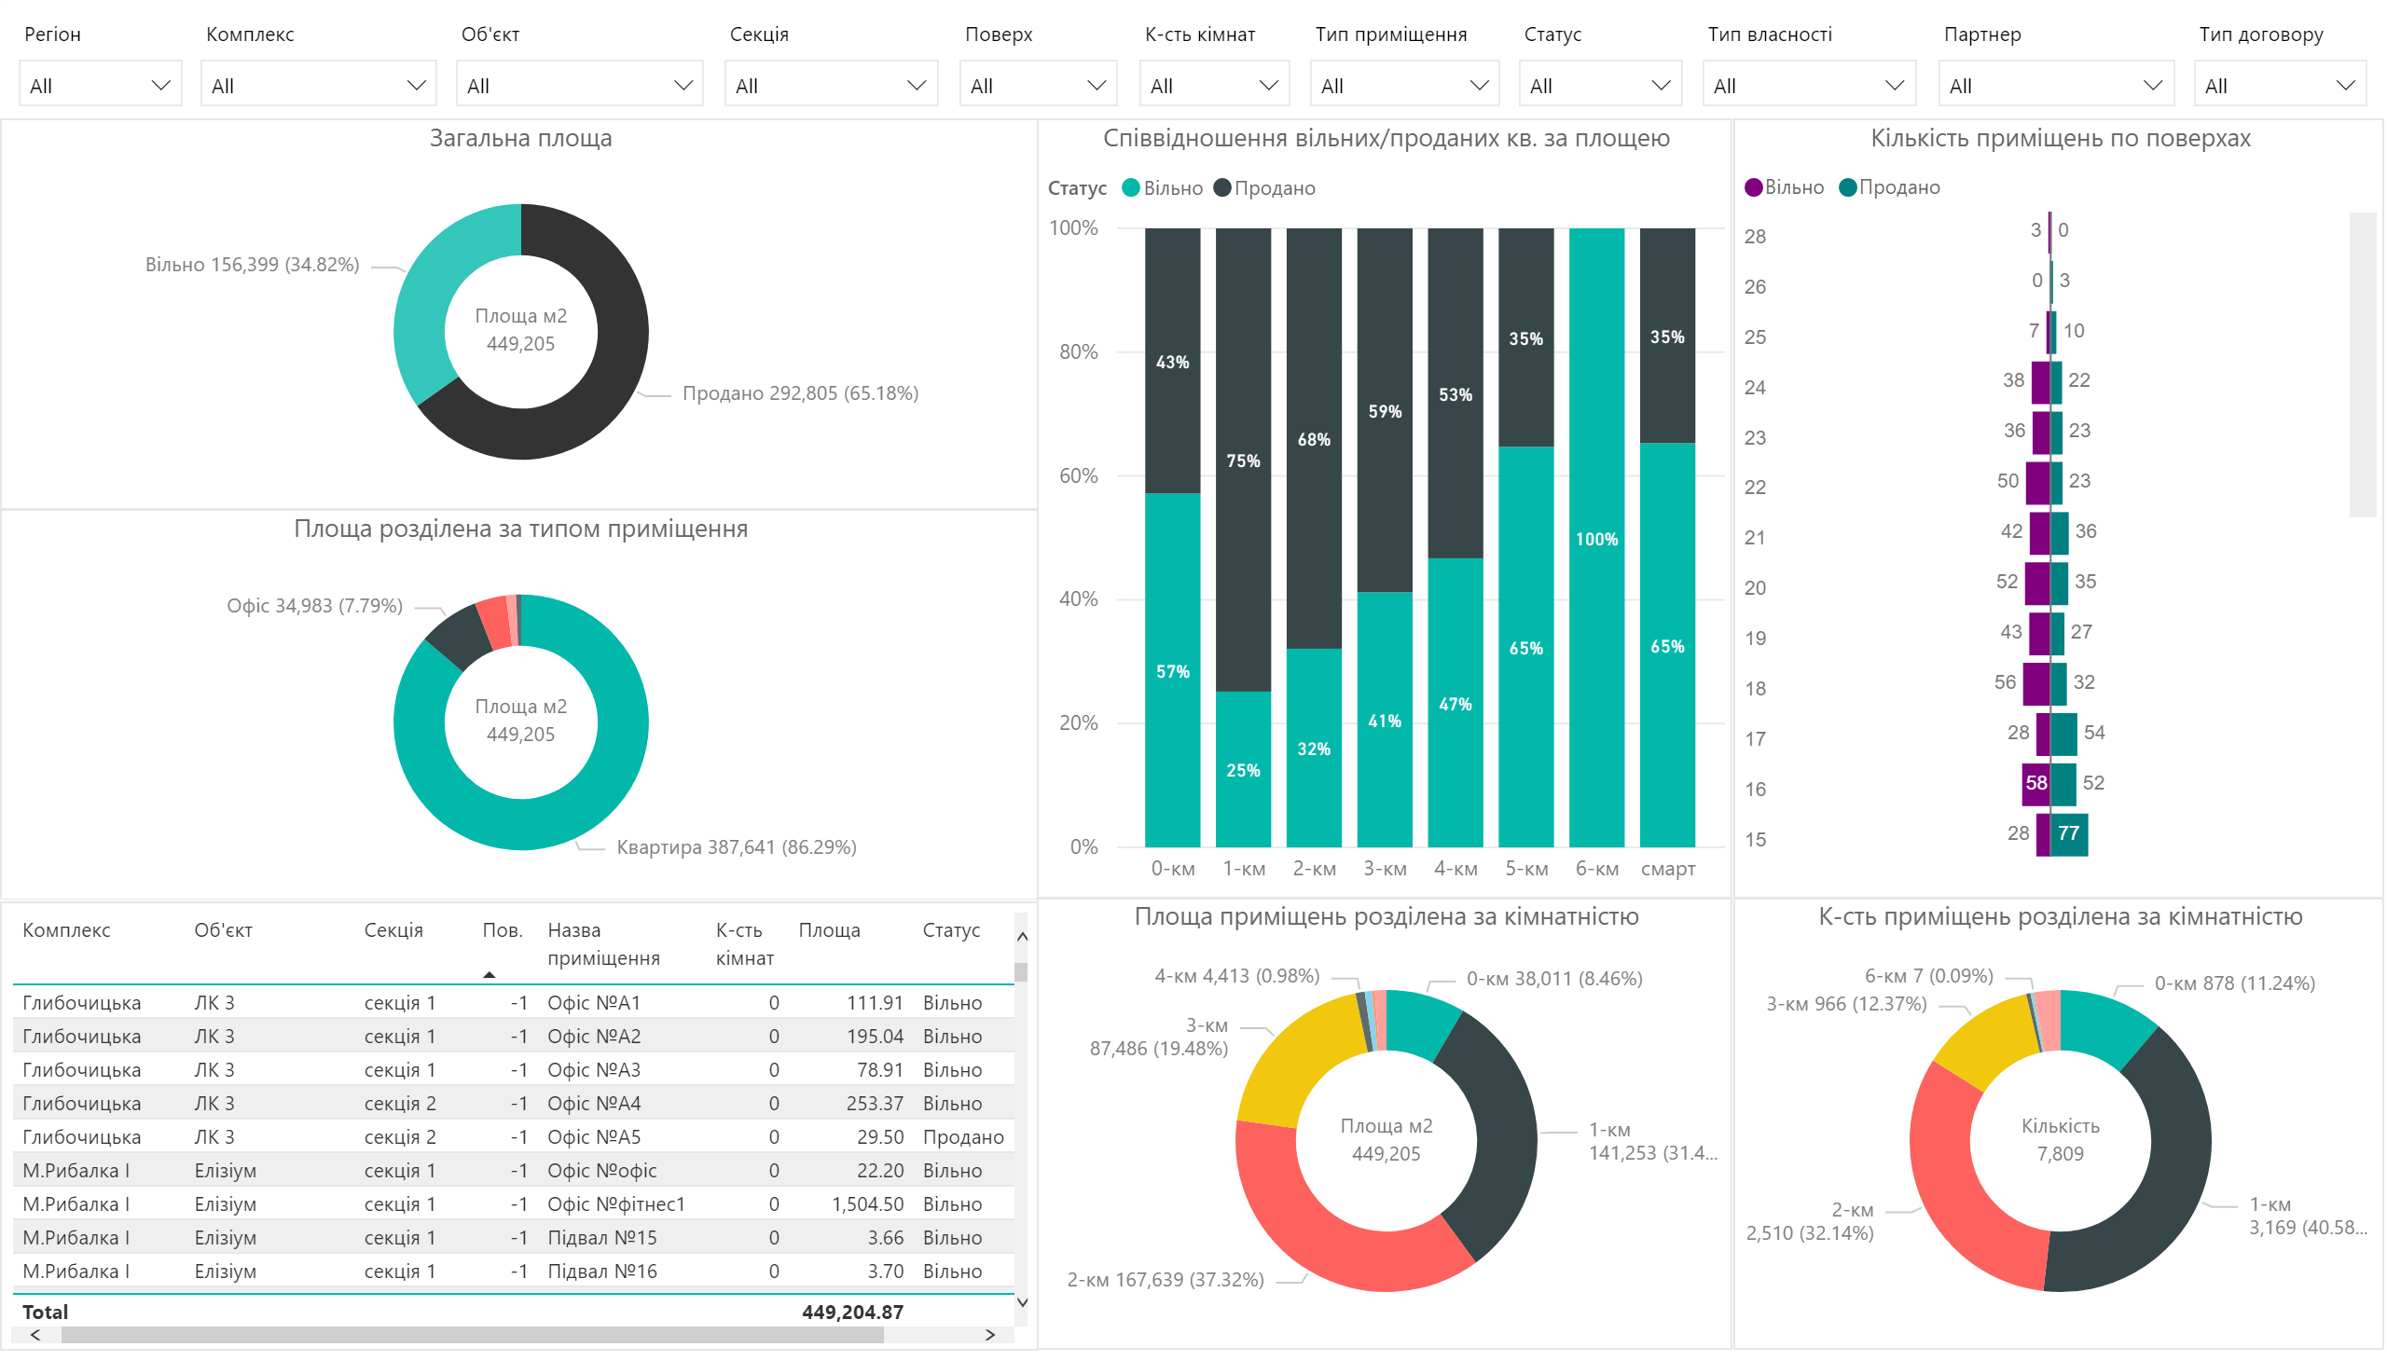

Slide 3
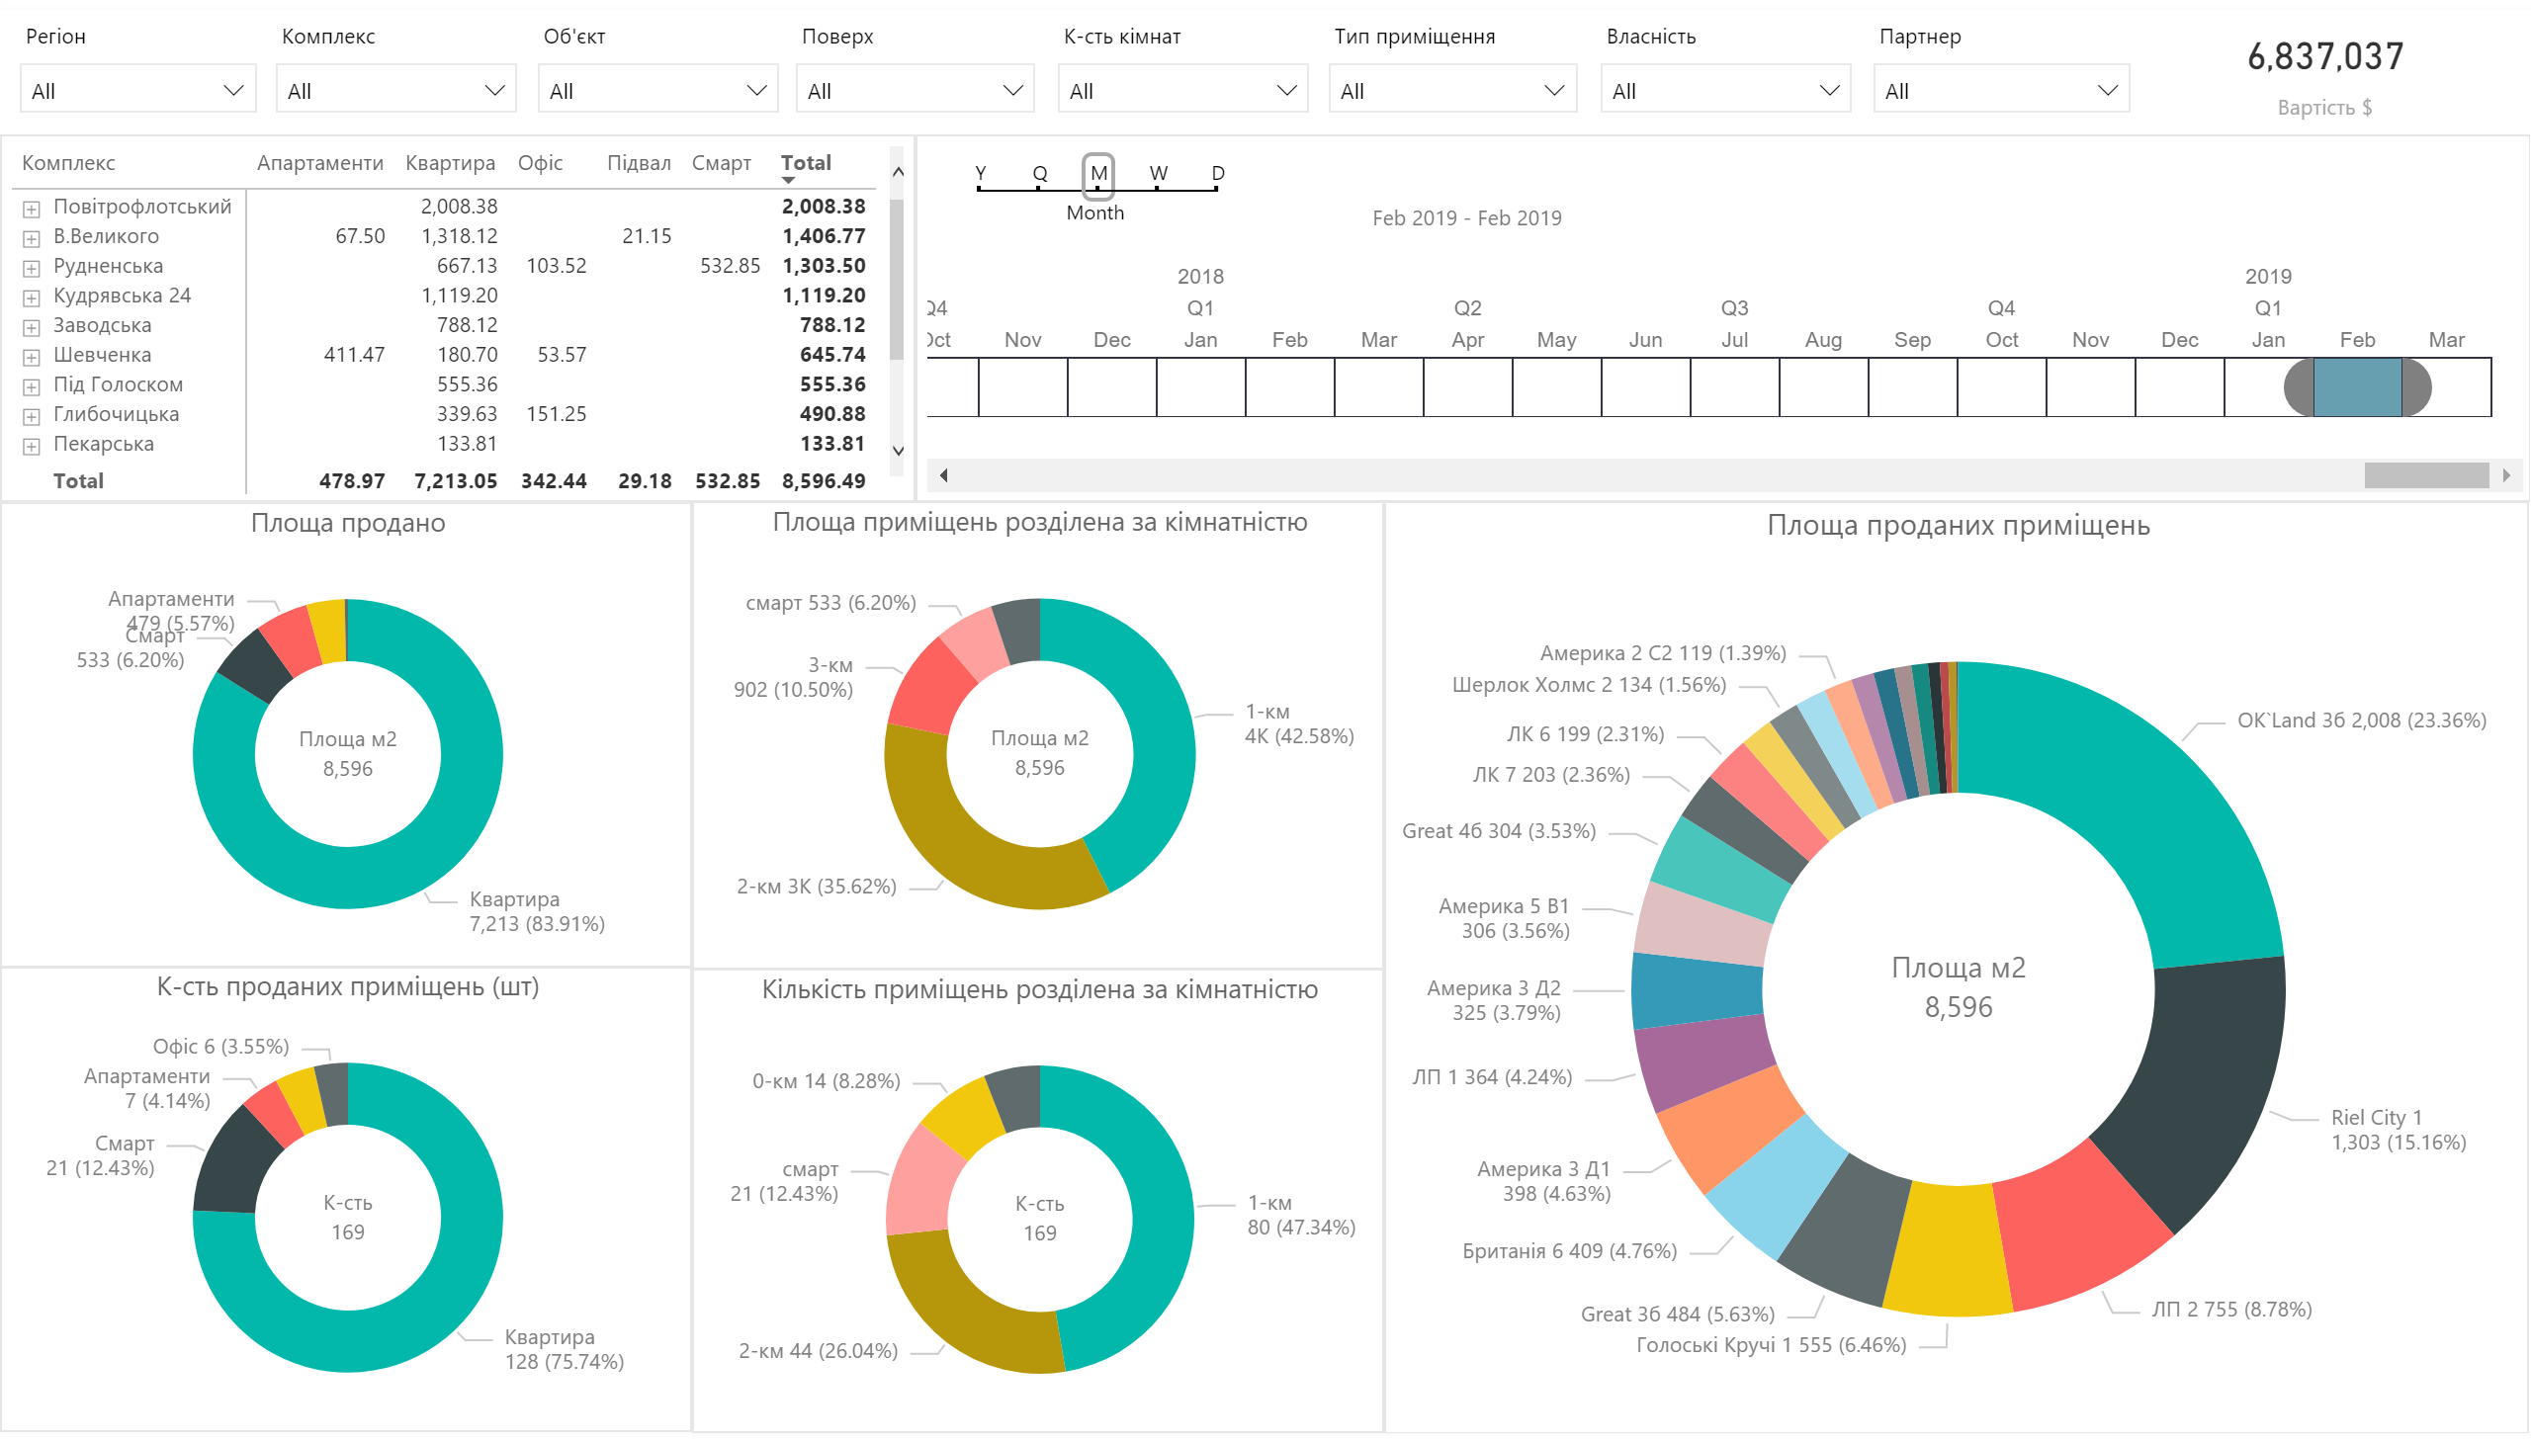

Slide 4
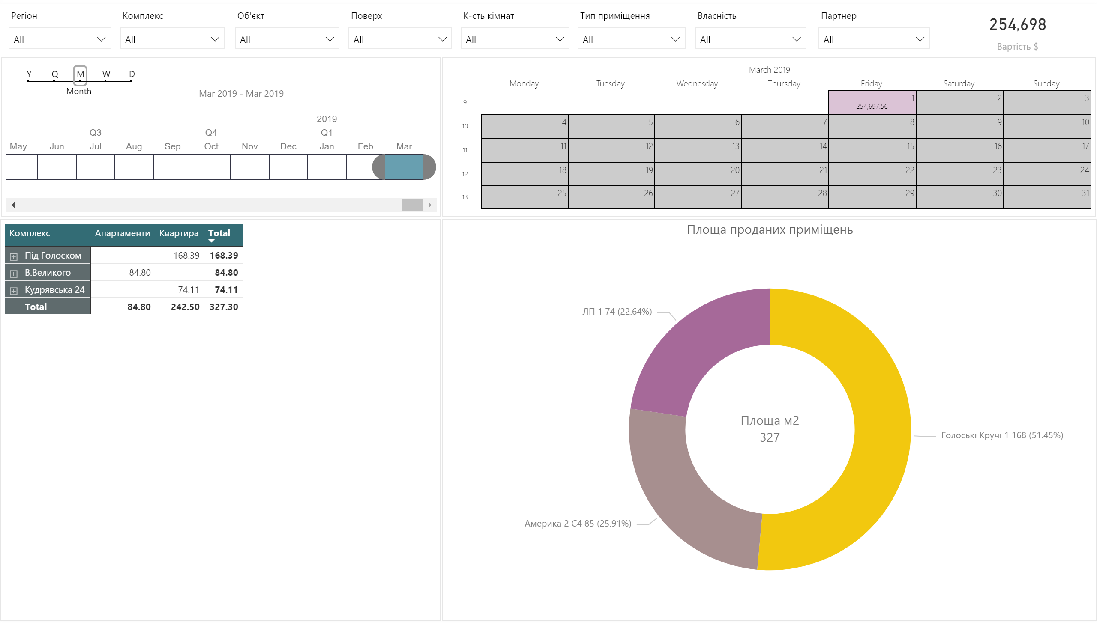

Slide 5
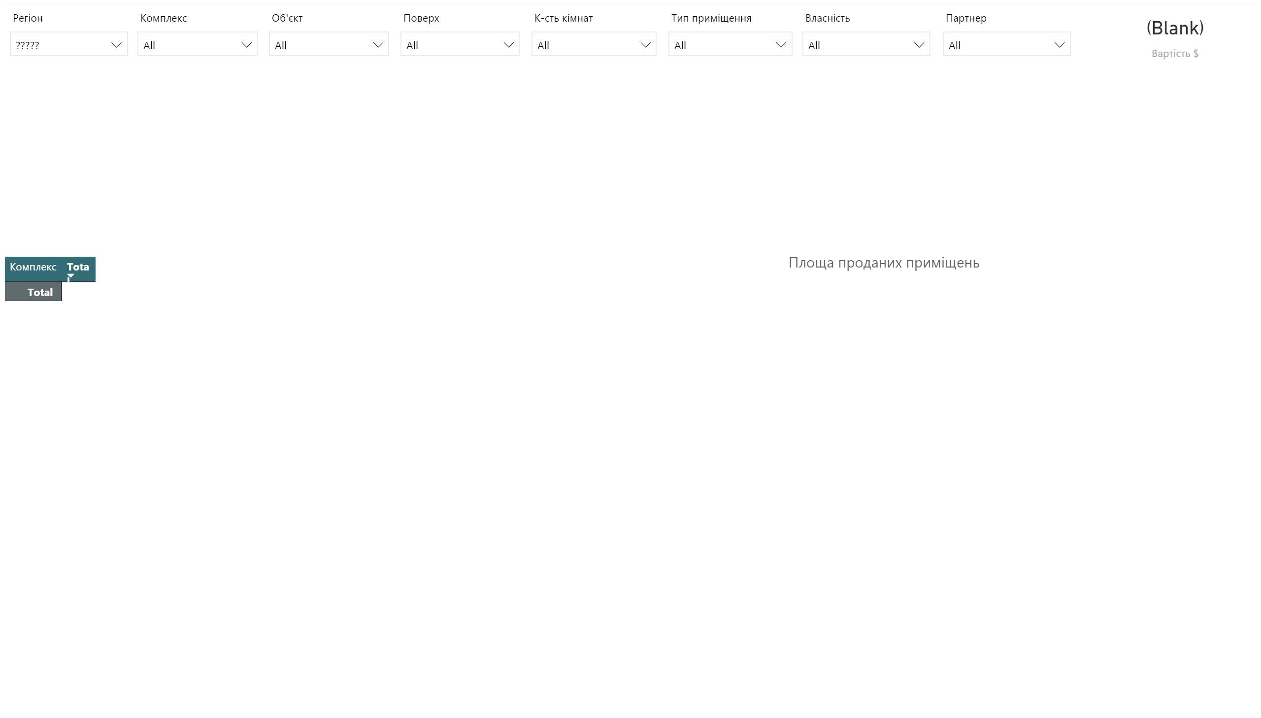

Slide 6
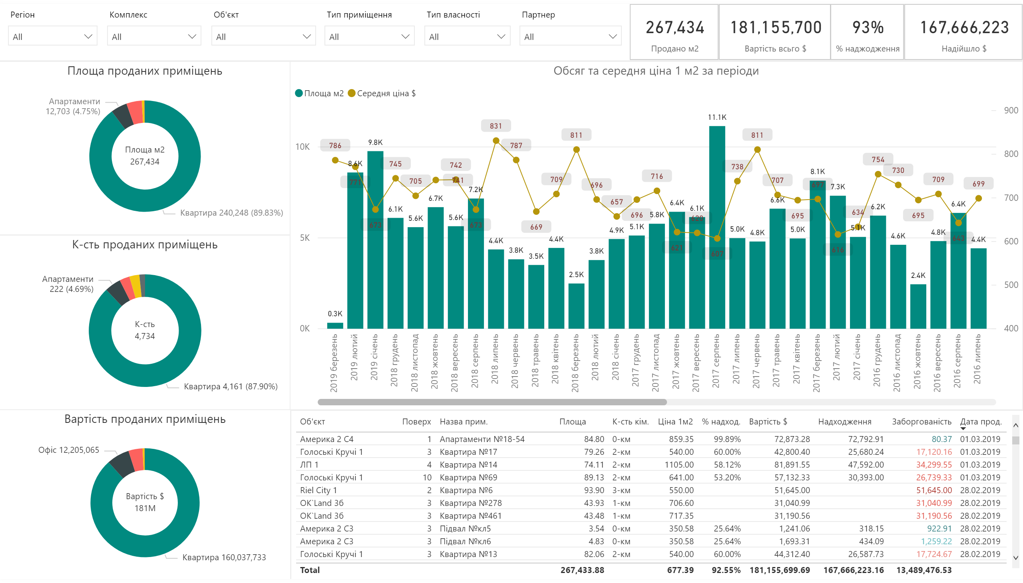

Slide 7
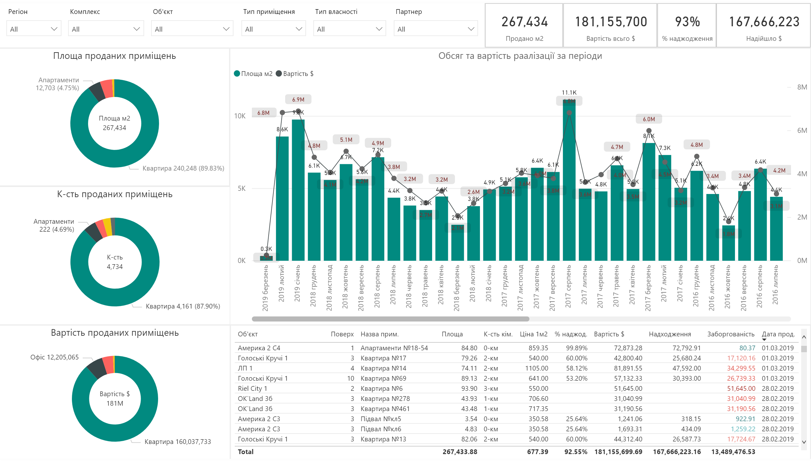

Slide 8
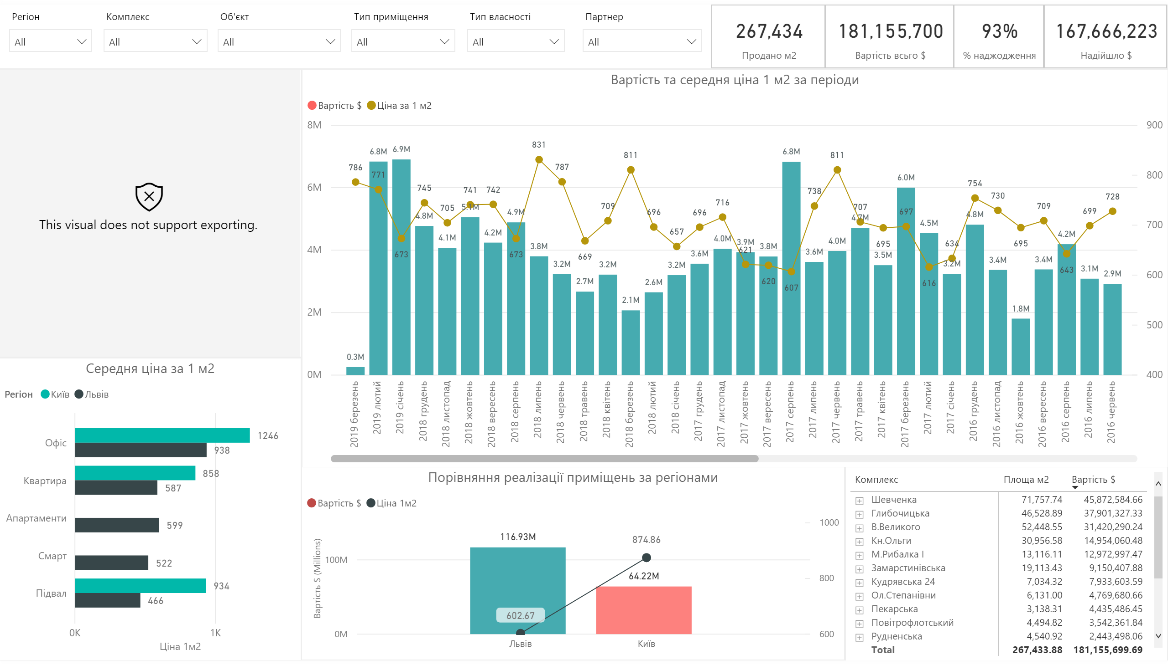

Slide 9
